Slide 1



Diet of the tiger rattlesnake, Crotalus tigris, in Southern Arizona
Arizona NASA Space Grant Statewide Symposium
April 23, 2022
Kristen Saban
Matt Goode
University of Arizona

Slide 2
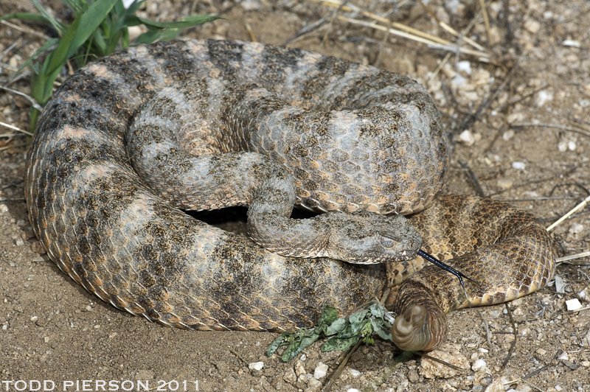
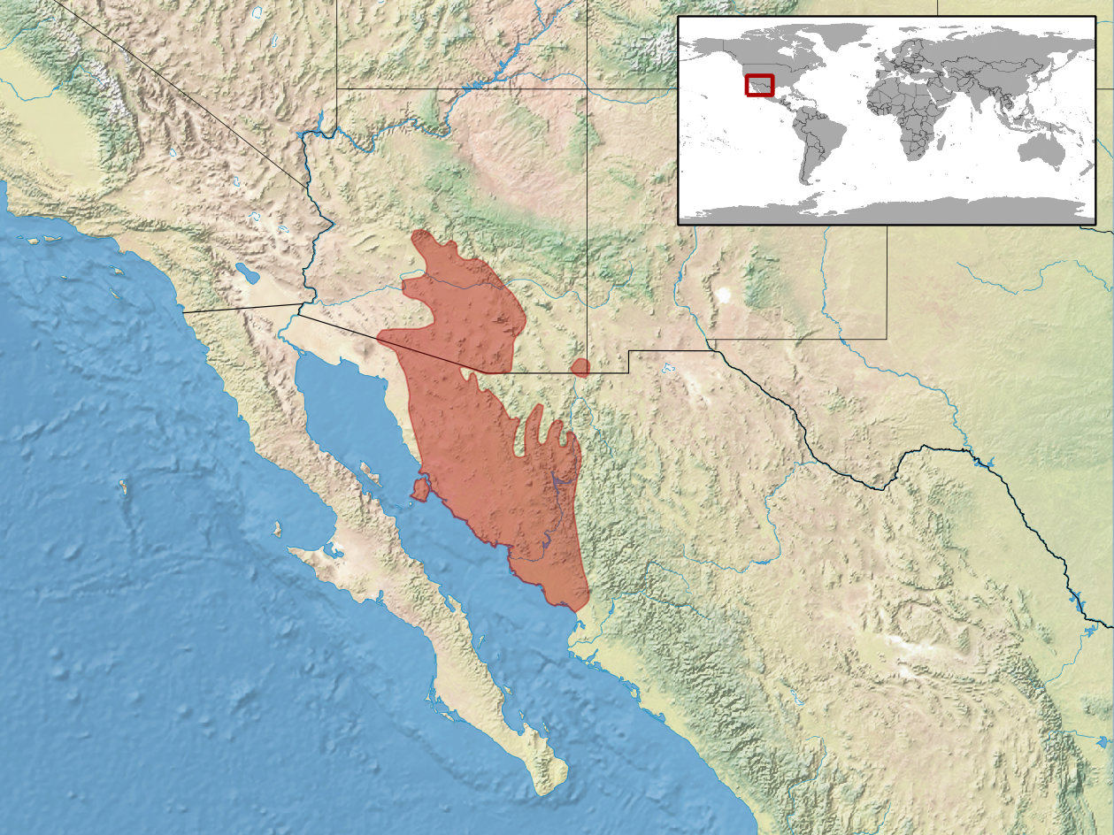
Introduction
Tiger Rattlesnake - Crotalus tigris (Kennicott, 1859)
  Habitat Range: Central Arizona, US through Southern Sonora, Mexico (Klauber 1997)
Diet Importance
  Diet is a fundamental aspect of an animal’s biology that has implications for ecology, evolution, behavior, and conservation (Schwenk 2000; Pough et al. 2009; Hickman et al. 2012; Karasov and Martínez del Rio 2020)
  In venomous snakes, diet has implications for venom complexity (Holding et al. 2021)
Yet, little is known about what affects diet variations in C. tigris
Photo by Todd Pierson, Reptile Database https://reptile-database.reptarium.cz/species?genus=Crotalus&species=tigris
Photo by Rbrausse, Wikipedia https://en.wikipedia.org/wiki/Tiger_rattlesnake#/media/File:Crotalus_tigris_distribution.png

Slide 3
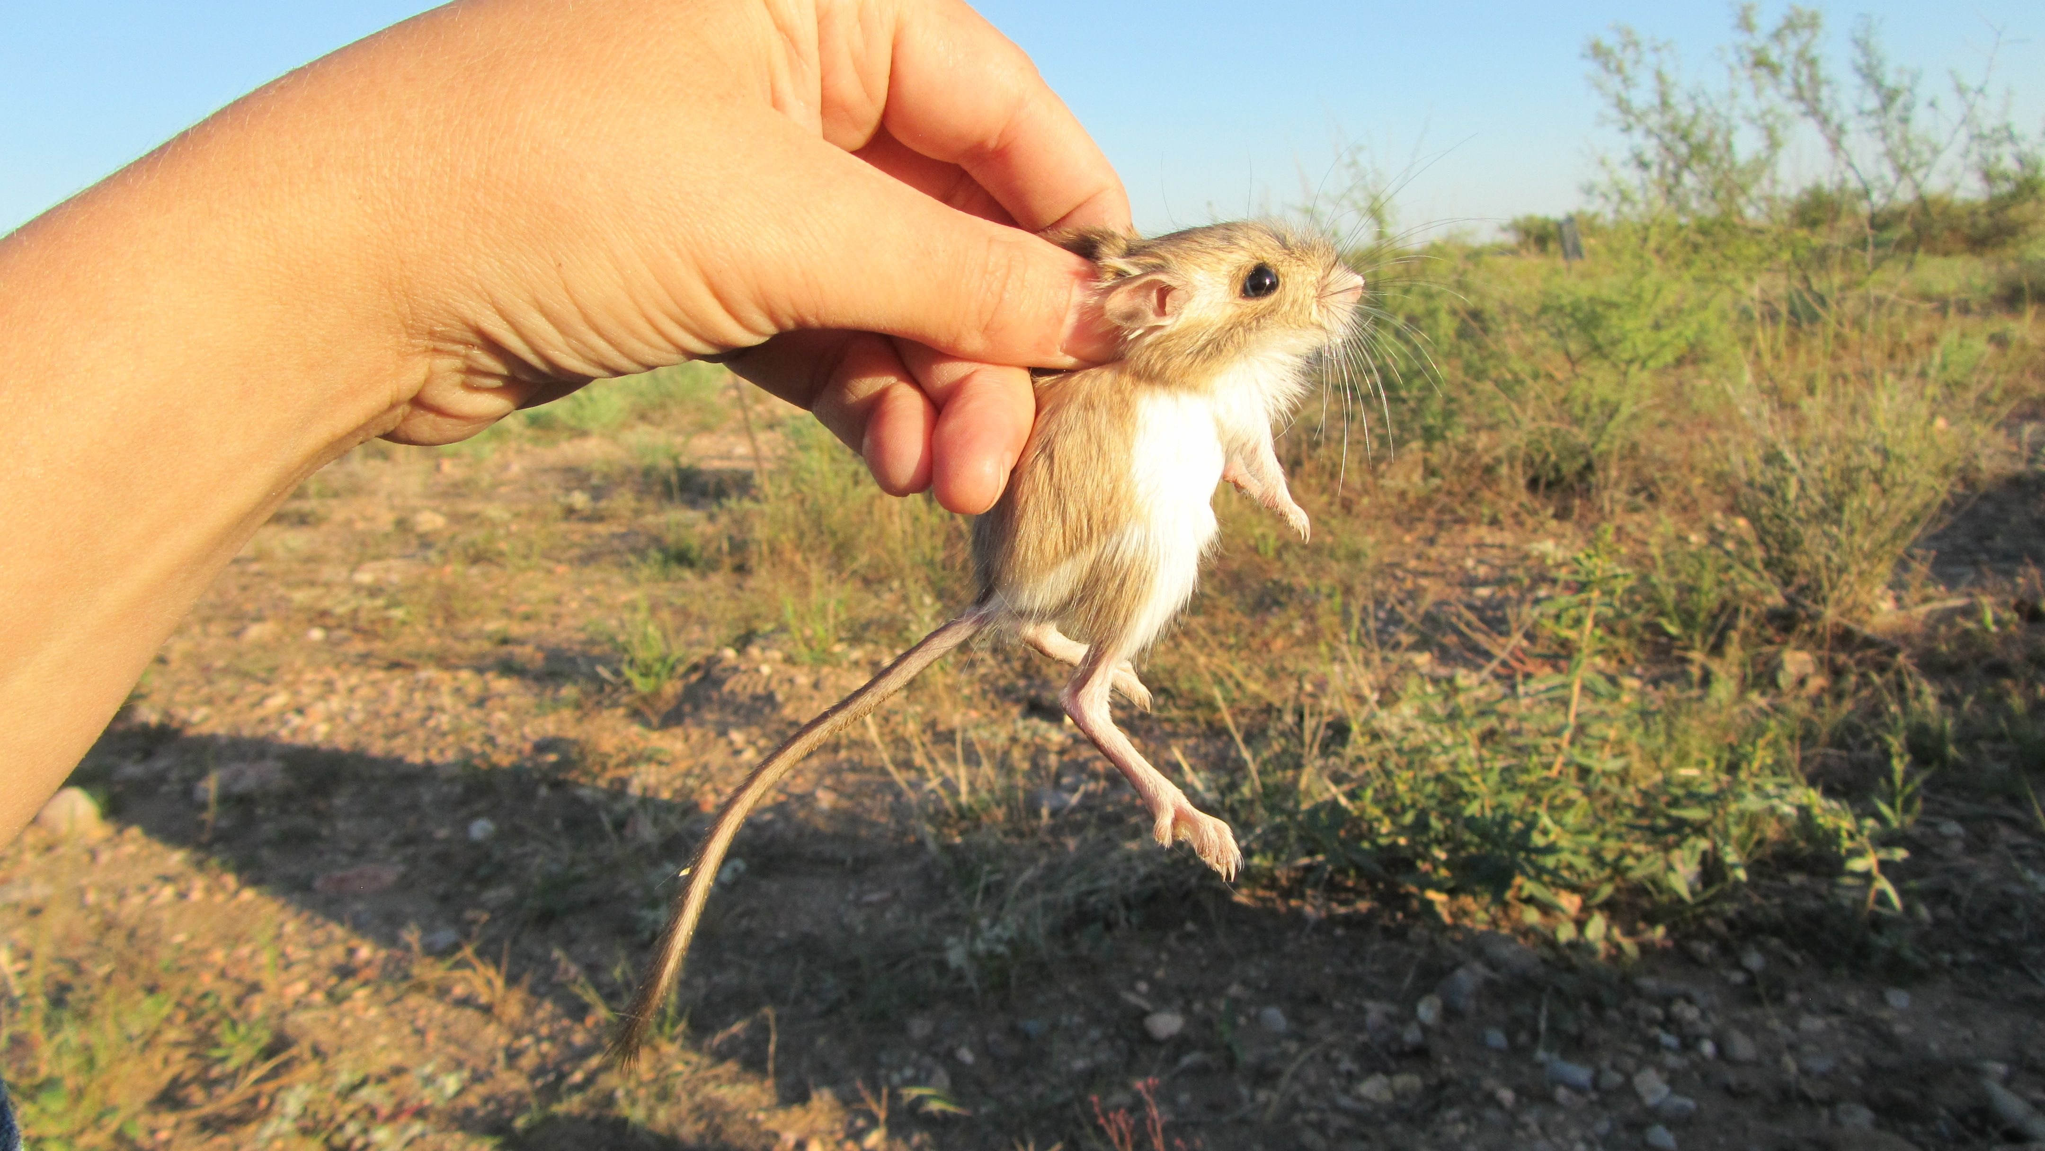
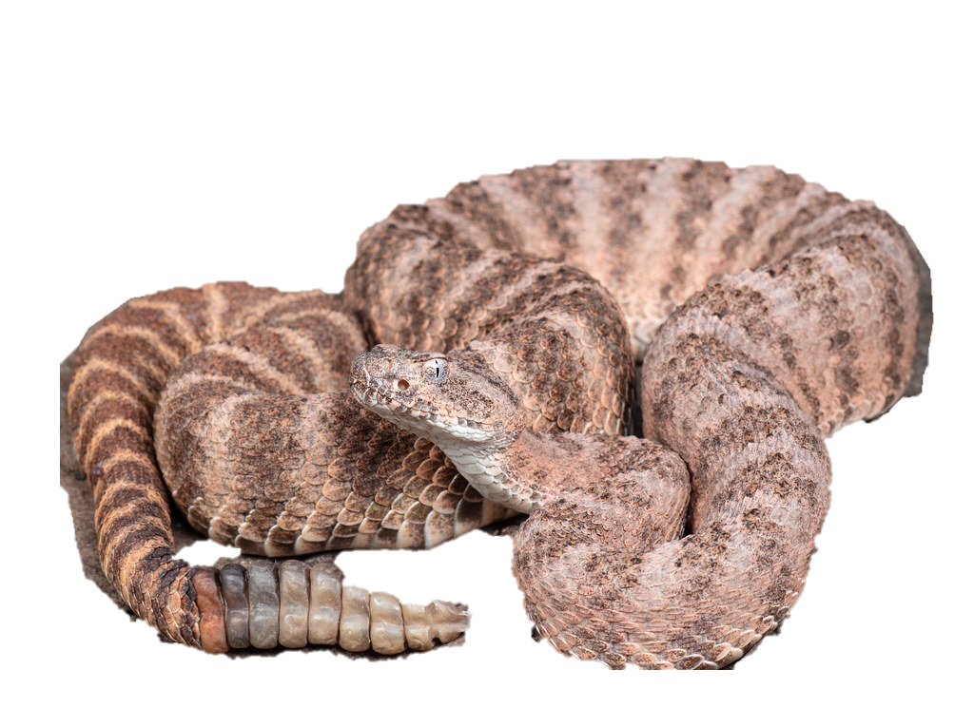
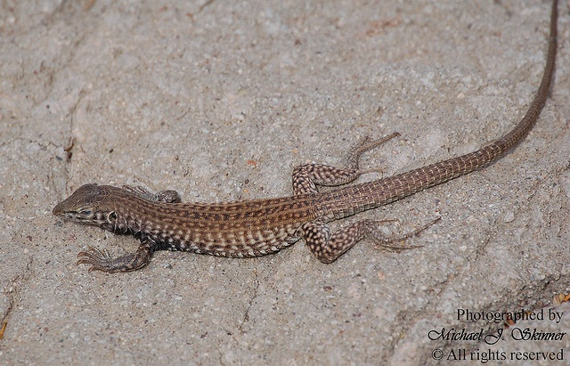
Objectives + Hypotheses
Categorize the relative proportions of lizards versus mammals in C. tigris diets
Determine the influence of body size on C. tigris diet
  Mass
  Snout-vent length (SVL)
  Head width (HW)
  Head length (HL)
  Tail length (TL)
Hypothesis: Larger body size will be correlated with mammal diets
Dipodomys merriami (Merriam’s kangaroo rat)
Photo from The Portal Project https://portalproject.wordpress.com/tag/kangaroo-rat/
Cnemidophorus tigris gracilis (Western Whiptail)
Photo from Michael Skinner, https://www.flickr.com/photos/12921146@N04/2486775710/

Slide 4

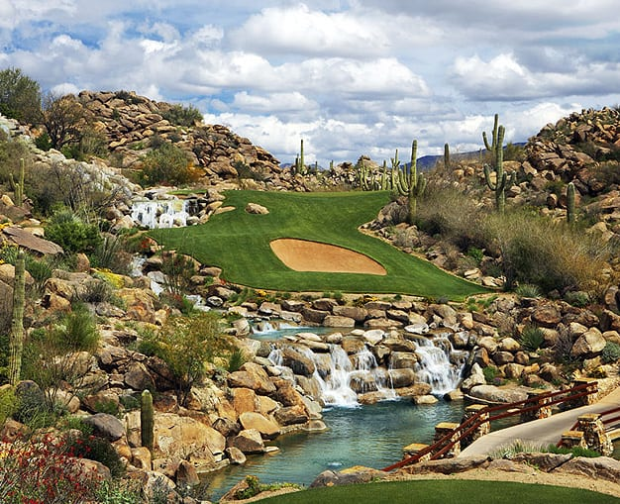
Data Collection Methods
Data were collected from C. tigris snakes at the Stone Canyon Club golf course in Oro Valley, Arizona between 2002 and 2013
A total of 1393 captures were recorded, representing 749 individual snakes
Measurements were taken on the following variables: mass, SVL, HW, HL, TL, age, sex
When possible, fecal samples were taken and later washed to determine diet
Fecal sample contents were categorized as follows: hair, bones, teeth, claws, scales, feathers, insect, plant, fangs
Photo from Golf Digest https://www.golfdigest.com/story/the-stone-canyon-club
Photo from Outside the Line https://www.otl-inc.com/project/stone-canyon-country-club/

Slide 5
Data Analysis Methods
This study focuses solely on the presence of hair or scales in the fecal content
Hair = mammal diet (M) , scales = reptile diet (R), hair and scales = mammal and reptile diet (MR)
Data representations and graphs were created in Microsoft Excel
ANOVAs between diet and body size were conducted in Excel
Logistic Regressions between diet and body size were conducted in R (version 4.0.5) in the package aod with the glm function

Slide 6


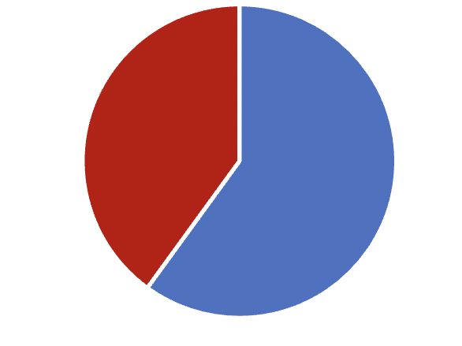
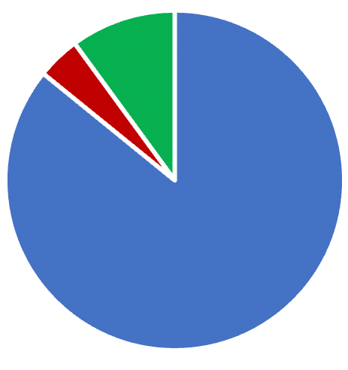



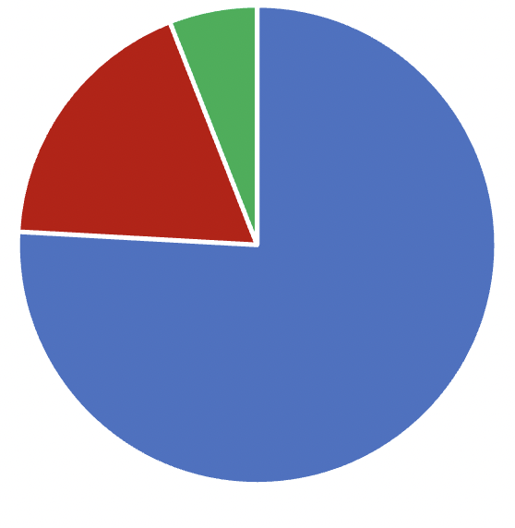

Results – Descriptive Data
59% male, 39% female (unknown sex for 2%)
86% adults, 4% juveniles, 10% neonates
327 captures had fecal samples (23.4%)
286 captures contained hair and/or scales (20.5%)
75.9% were mammal diets, 18.2% were mammal and reptile diets, 5.9% were reptile diets

Slide 7
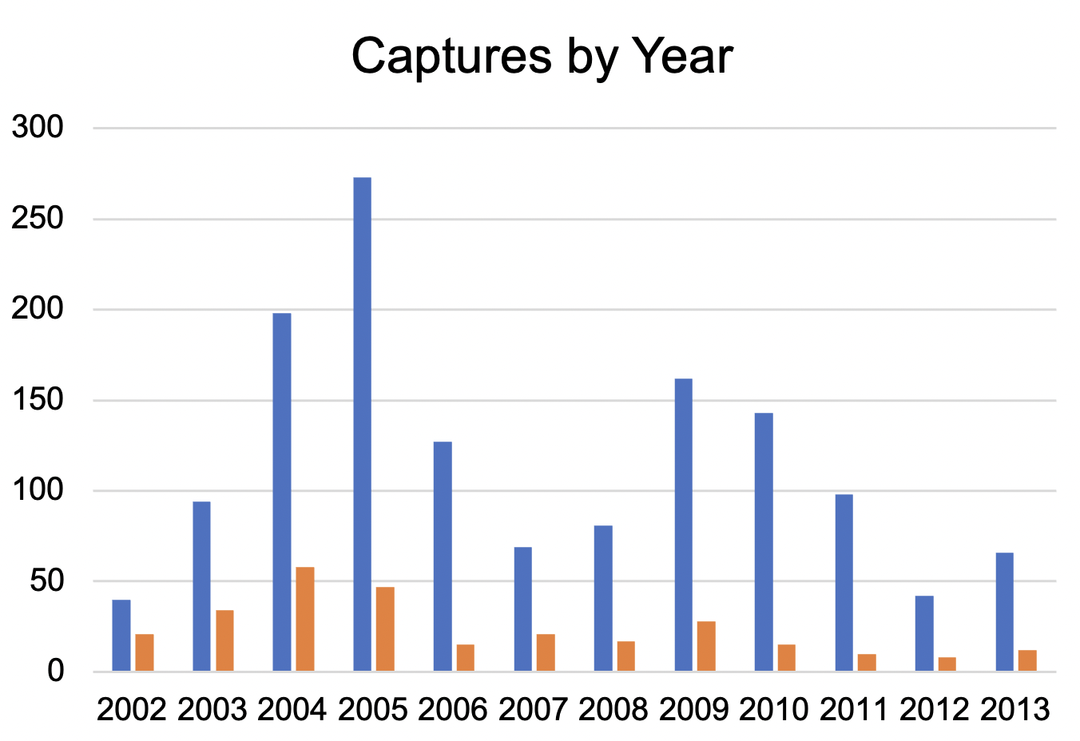
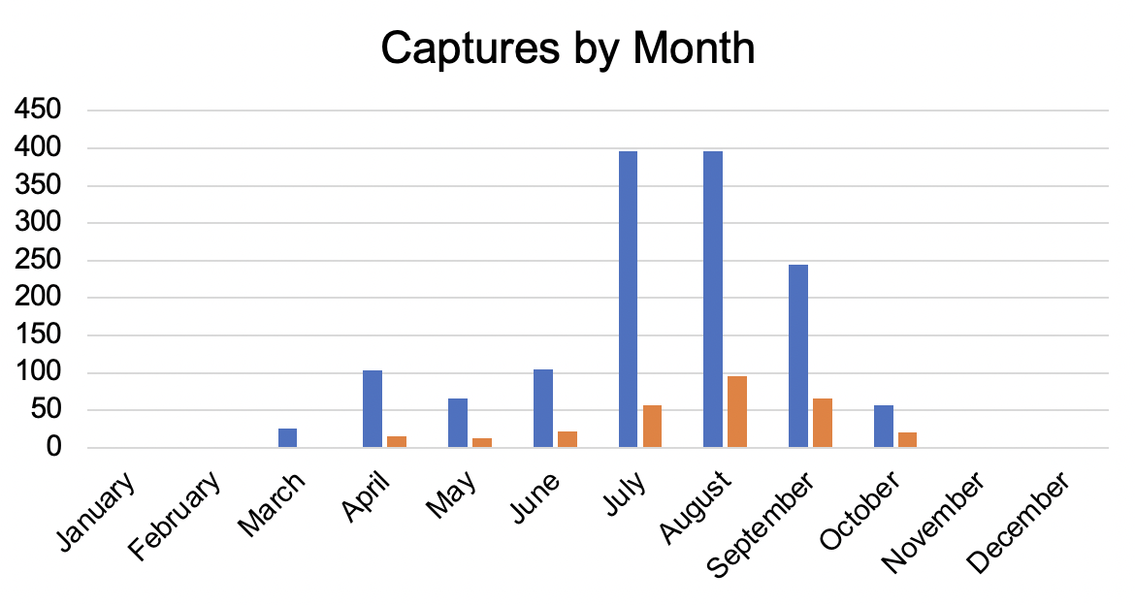

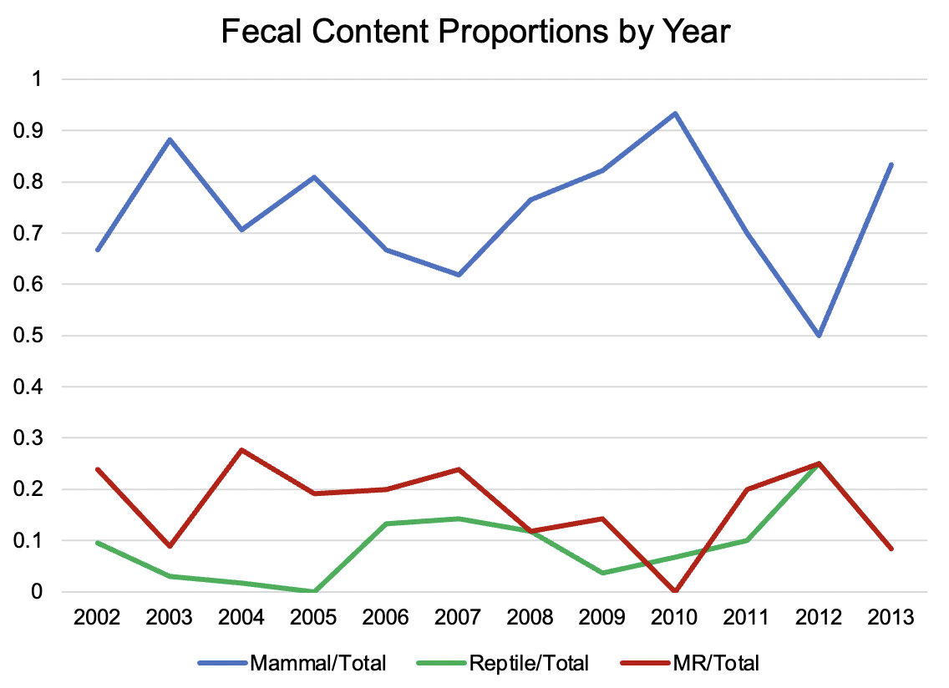
Results – Time
The number of captures and fecal samples varied each year, spiking in 2005
Most captures and fecal samples are from July and August
Mammals consistently made up the majority of diets

Slide 8
Results – Body Size
For all body size variables, the mammal and combination diets are on average higher than only reptile diets

Slide 9
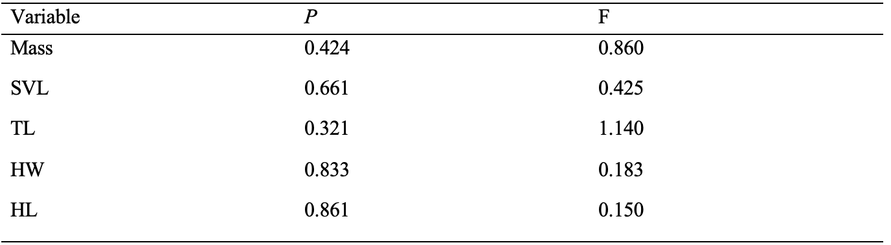
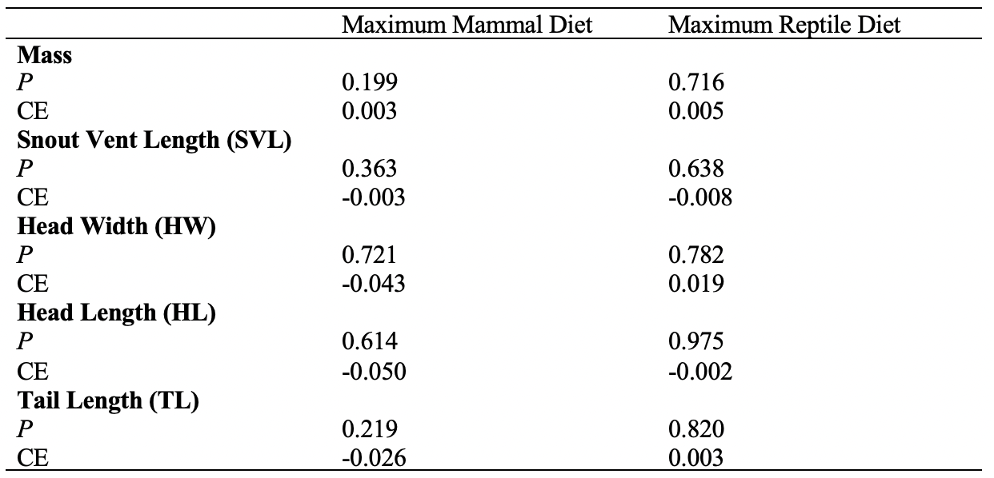
Results – Body Size
ANOVA
  Does diet (independent) influence the body size (dependent)?
  No significant results
Logistic regressions
  Does body size (independent) influence diet (dependent)?
  No significant results
Table 1. ANOVA results between three diet classifications (M, MR, R) and five body size measurements.
Table 2. Logistic regression results between three diet classifications (M, MR,
R) and five body size measurements.

Slide 10
Discussions
While no results were statistically significant, the average body size of mammal or combination diets is larger than the average size of the reptile-only diet
  This may be due to the larger size of mammals than lizards, placing a gape-width and size limitation on mammal diets
  Lack of statistical significance may be due to sample size limitations
The variations in capture and fecal sample numbers over the years may be due to variations in effort each season
Future investigations will include variation in individual snake diet, correlations between diets and climate and urban development, and comparisons with similar rattlesnake species

Slide 11
References
Hickman, C., Roberts, L., Keen, S., Larson, A., and Elsenhour, D. 2012. Animal diversity. McGraw-Hill, NY, USA.
Holding, M., Strickland, J., Rautsaw, R., Hofmann, E., Mason, A., Hogan, M., Nystrom, G., Ellsworth, S., Colston, T., Borja, M., Castañeda-Gaytán, G., Grünwald, C., Jones, J., Freitas-de-Sousa, L., Viala, V., Margres, M., Hingst-Zaher, E., Junqueira-de-Azevedo, I., Moura-da-Silva, A., Grazziotin, F., Gibbs, H., Rokyta, D. and Parkinson, C., 2021. Phylogenetically diverse diets favor more complex venoms in North American pitvipers. Proceedings of the National Academy of Sciences, 118(17).
Karasov, W., and Martínez del Rio, C.. 2020. Physiological ecology: how animals process energy, nutrients, and toxins. Princeton Univ. Press, Princeton, NJ, USA.
Klauber, L. Rattlesnakes: Their Habitats, Life Histories, and Influence on Mankind, 2nd ed.; University of California Press: Berkeley, 1997.
Pough, F., Janis, C., and Heiser, J. 2009. Vertebrate life. 8th ed. Pearson, San Francisco, CA, USA.
Schwenk, K. (editor) 2000. Feeding: form, function, and evolution in tetrapod vertebrates. Academic Press.

Slide 12
Acknowledgements
Dr. Matt Goode
University of Arizona School of Natural Resources and the Environment
NASA Arizona Space Grant Consortium

Slide 13
Thank You!

